Slide 1

Power Platform Governance Understanding Environments

Slide 2
Disclaimer

Slide 3
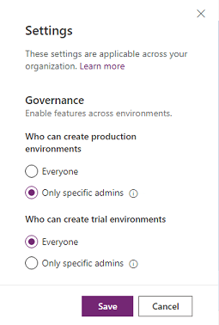
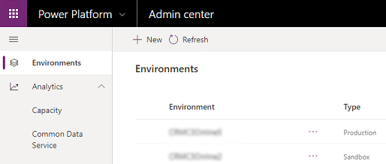
Environment
Definition:
Container to store, manage, and share your organization's business data, apps, flows, chatbots and other Power Platform resources.
Serves as a container to separate apps that might have different roles, security requirements, or target audiences.
Key facts:
Created under an AAD tenant, resources can only be accessed by tenant users.
Tied to a geographic location
Different types of environment exists
Can have either zero or one Dataverse database
Every tenant has a Default environment where all licensed Power Apps and Power Automate users can create apps & flows.
Controlling environment creation in the admin center.
Security tips:
Non-default environments offer more permission controls.
Non-default environment creation can be restricted to specific admins.
Non-default and non-developer environments with Dataverse can be restrict access to a specific AAD security group.
MICROSOFT CONFIDENTIAL
List of environments in the admin center.
Notes:
Power Platform is built in distinct environments. Environments are containers that administrators can use to manage apps, flows, connections, and other assets; along with permissions to allow organization users to use the resources. Environments are tied to a geographic location that is configured at the time the environment is created. Environments can be used to target different audiences and/or for different purposes such as dev, test and production. The actual number and purpose of environments in your tenant is up to you as an administrator.
There are some key facts you should know about environments:
Environments are tied to a geographic location that is configured at the time the environment is created
Environments can be used to target different audiences and/or for different purposes such as dev, test and production
Every tenant has a Default environment where all licensed PowerApps and Flow users can create apps & flows
Non-default environments offer more control around permissions
Non-default environment creation can be restricted to only global and service admins from the Power Platform admin center: https://aka.ms/ppac

Slide 4
Environment Types More details in upcoming slides
Type | Creator | Description
Default | Auto-created | A single default environment is automatically created for each tenant and shared by all users (who are Environment Makers).
Production | Licensed user, subject to tenant level setting | This is intended to be used for permanent work in an organization. Production environments are what you should use for any environments on which you depend.
Sandbox | Licensed user, subject to tenant level setting | Sandbox environments are used for development and testing, separate from production.
Trial | Licensed user, subject to tenant level setting | Trial environments are intended to support short-term testing needs and are automatically cleaned up after a short period of time.
Developer | Licensed user | Developer environments are created by users who have the free Power Platform Developer Plan license. They're special environments intended only for use by the owner
Dataverse for Teams | Auto-created | Dataverse for Teams environments are automatically created for a Team in Teams when you create an app in Teams using the Power Apps app for the first time or install a Power Apps app from the app catalog.
Support | Microsoft support engineer | It is an environment created in your tenant by Microsoft under your direct instructions, for purposes of preventing, detecting, or repairing problems affecting the operation of your online service.
Notes:
As we mentioned, there are different types of environments ranging from trial to production.

Slide 5
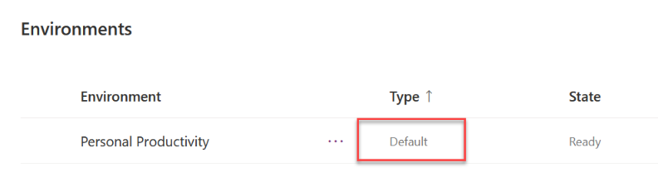
Default Environment
Default environment
Definition:
A single default environment is automatically created for each tenant and is shared by all users in the tenant (who are Environment Makers). Learn more here.
Key facts:
Whenever a new user creates their first Power App or Power Automate flow, they're automatically added to the Environment Maker role
Default is not for development of critical apps.
Can't be disabled or deleted
You can't backup and restore the default environment.
Limited to 32 GB of storage capacity.
Security tips:
Rename the environment to make the purpose of that environment self-explanatory like “Personal Productivity”
Configure a Data Loss Prevention (DLP) policy to control the connectors that can be used by apps and flows in the default environment.

Slide 6
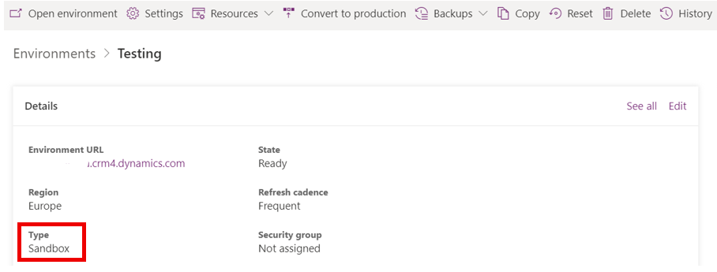
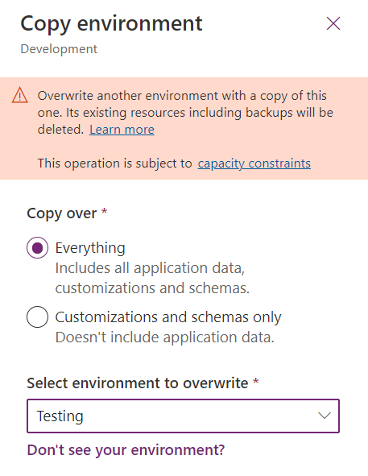
Default Environment
Sandbox environment
Definition:
Is any non-production environment of Microsoft Dataverse. Isolated from production, a sandbox environment is the place to safely develop and test application changes with low risk. Learn more here.
Key facts:
Can be converted to Production environment
Possible to create own backups along system backups and restore backups 7 days back in time (28 days if any Dynamics 365 app is deployed to environment)
Copy Dynamics 365 customer engagement apps (Sales, Customer Service, Field Service, Marketing, and Project Service Automation), and all data between environments
Reset to delete and reprovision it.
If environment has AAD Security Group defined, then you need to set new group during the reset.
Consider a reset when you want to; Create a new project, free up storage or remove personal data

Slide 7
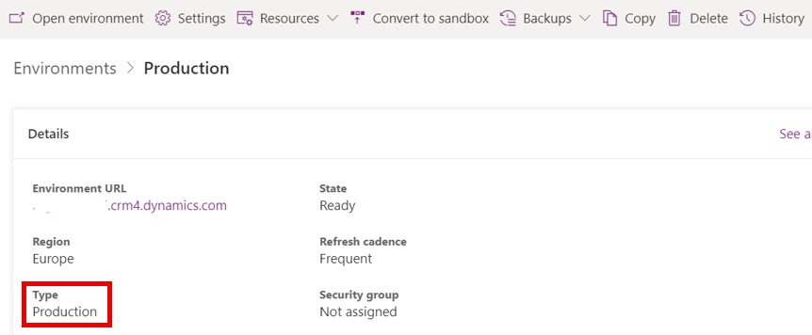
Default Environment
Production environment
Definition:
Environment for resources like apps, flows, chatbots etc. which are meant to be released target audience e.g., end users of a Power App
Key facts:
Can be converted to Sandbox environment
Possible to create own backups along system backups and restore backups 7 days back in time (28 days if any Dynamics 365 app is deployed to environment)
Copy Dynamics 365 customer engagement apps (Sales, Customer Service, Field Service, Marketing, and Project Service Automation), and all data between environments

Slide 8
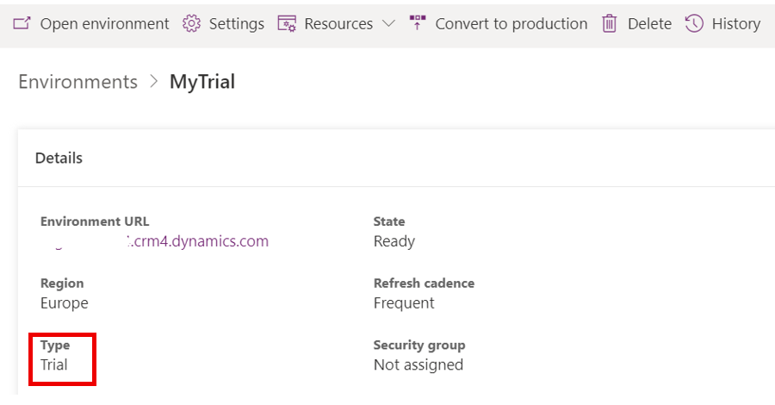
Default Environment
Trial environment
Definition:
Using trial environments, companies can try out new features and solutions. Learn more here.
Two types of trial environments:
Trial (standard) - Allow users to try new features and quickly build low-code and no-code applications and processes.
Trial (subscription-based) - Companies can use to develop larger, multiuser and multiple-department solutions and perform proof-of-concept reviews. Tenant admins can add a trial (subscription-based) environment to their tenant, or new customers can sign up for a new tenant and become the Global admin
Key facts:
Users with eligible license like Power Apps per User can create one trial environment at a time
Does not consume paid capacity of the tenant
Can be converted to Production environment
Will be automatically deleted after 30 days but can be extended for additional 30 days 7 days before environment is set to expire. Only one extension is allowed per trial environment

Slide 9
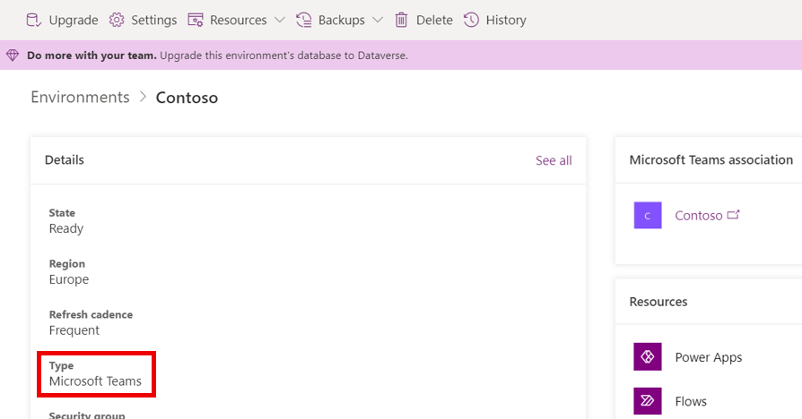
Default Environment
Dataverse for Teams environment
Definition:
Is automatically created for the selected team when you create an app or bot in Microsoft Teams or install a Power Apps app from the app catalog for the first time.
Each team can have one environment, and all data, apps, bots, and flows created with the Power Apps app inside a team are available from that team's Dataverse for Teams database.
Learn more here.
Key facts:
Available as part of select Microsoft 365 subscription like E3/E5
Possible to create own backups along system backups and restore backups 7 days back in time
Team guests can access apps, bots, flows and data but not able to make or edit apps; only discover and run
Dataverse for Teams database (“light version” of Dataverse) can be upgraded to full version of Dataverse

Slide 10
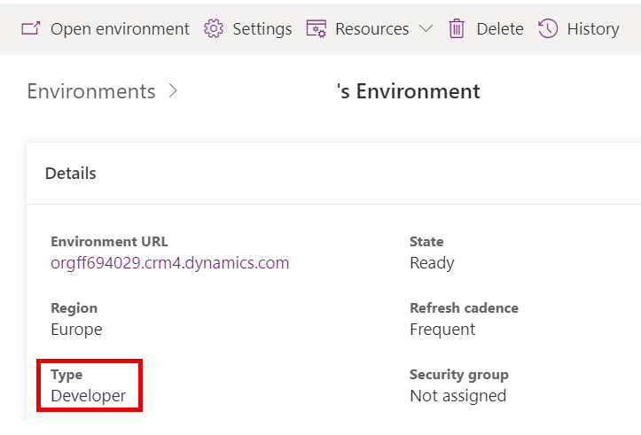
Default Environment
Developer environment
Definition:
You get a free developer environment to develop and test apps, including support for premium and custom connectors and Dataverse. Learn more here.
Key facts:
Create apps and flow and share and collaborate on these solutions with others.
Connect to any data source by using OOB connectors or by creating custom connectors.
Use a fully managed, scalable data platform with Dataverse’
Create more environments to exercise application lifecycle management (coming soon).
Export the solutions you create in your developer environment, and publish them on Microsoft AppSource so your customers can test-drive them.
Not meant for production use
Environment capacity limits are:
Flow runs/month – 750
Database size – 2GB

Slide 11
Default Environment
Create an environment
You can create environments in the Power Platform admin center or using PowerShell
Environment can be created either with or without Dataverse database
To create an environment, all the following must be true:
The user has a license that allows environment creation
Environment creation is allowed in tenant level (if user is not Global, Power Platform or Dynamics Admin)
For production and sandbox environments, the tenant must have at least 1GB of database storage capacity available
For trial (subscription-based) environments, each offer-based trial (also known as "admin trial") subscription entitles the tenant to three subscription-based trial environments. Only tenant-level admins are able to provision trial (subscription-based) environments.
For trial (standard) environments, the user needs a license providing per-user entitlement for trial environments (refer to the table above). This applies to tenant-level admins, as well.
License | Trial | Production
Microsoft 365 Plans | No | No
Dynamics 365 Teams Plans | No | No
Power Platform Developer Plan | No | No
Dynamics 365 trial | Yes (one) | No
Dynamics 365 Plans | Yes (one) | Yes
Power Apps plan | Yes (one) | Yes
Power Apps trial | Yes (one) | Yes
Power Virtual Agents trial plan | Yes | No
Power Virtual Agents plan | No | Yes
NOTE! Global and Power Platform Administrators can create environments without any license

Slide 12
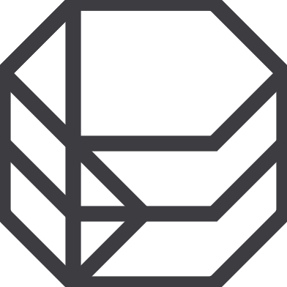
Develop Your Environment Strategy
Environments are containers that administrators can use to manage apps, flows, connections, and other assets; along with permissions to allow organization users to use the resources
Azure AD Tenant
CONTOSO CORP.
Contoso EMEA (default)
Contoso EMEA (default)
Contoso EMEA (default)
Environments
Dev
Contoso EMEA (default)
Dev
Contoso EMEA (default)
Dev
Contoso EMEA (default)
Test
Contoso USA
Test
Contoso USA
Test
Contoso USA
Prod
Prod
Prod
PowerApps
Flows
CDS
PowerApps
Flows
CDS
PowerApps
Flows
CDS
PowerApps
Flows
CDS
PowerApps
Flows
CDS
PowerApps
Flows
CDS
PowerApps
Flows
CDS
PowerApps
Flows
CDS
PowerApps
Flows
CDS
Notes:
Power Platform is built in distinct environments. Environments are containers that administrators can use to manage apps, flows, connections, and other assets; along with permissions to allow organization users to use the resources. Environments are tied to a geographic location that is configured at the time the environment is created. Environments can be used to target different audiences and/or for different purposes such as dev, test and production. The actual number and purpose of environments in your tenant is up to you as an administrator.

Slide 13
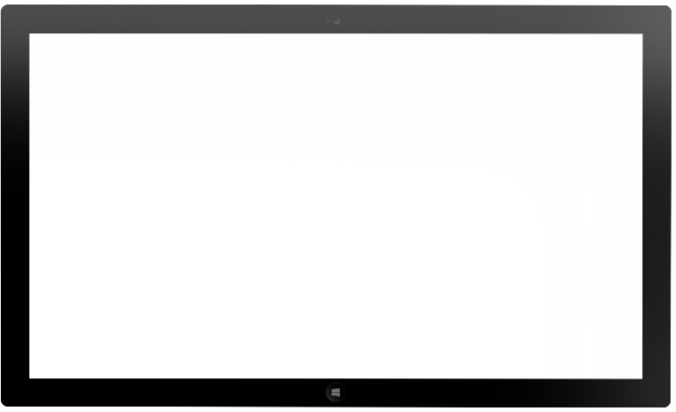

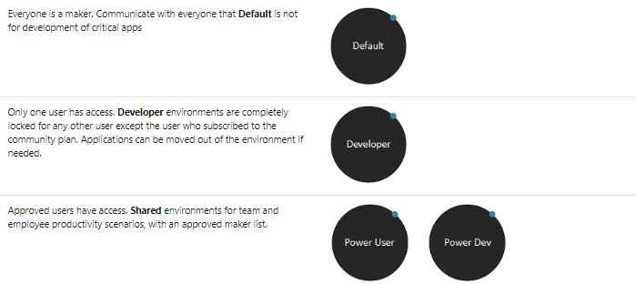



Tiered approach to Team and Employee Productivity environments
Default Environment: Everyone is a maker. Apply a restrictive DLP policy to reduce risk to data.
Power User Environment: Shared environment, admins control the maker list. Less restrictive DLP policy.
Power Dev Environment: Shared environment for more complex scenarios, admins control the maker list. Less restrictive DLP policy.
Training environments: Shared environment for internal training events, trainers control maker list. DLP policy to allow for training scenarios.
Notes:
Default Environment
Everyone in your tenant has permissions to create apps and flows here. There currently is no way to block the Environment Maker role assignment in this environment. This is also the environment that is used for first party integrations, like creating an app from a SharePoint list. Learn more: The default environment
To reduce risk to data, the types of connectors used in your apps and flows should be limited to a restrictive DLP policy. This policy should cover common individual and small team productivity use cases, like working with SharePoint data, sending emails, and having an approval workflow.
Power User Environment
While the Default environment covers many use cases, some power users will have more advanced needs for their apps and flows, like integrating with Microsoft Teams, Azure AD or Azure DevOps.
For this purpose, we recommend creating a Power User environment. This shared environment should use less risk averse DLP policies and admins should strictly control the maker list to this environment.
Some considerations for the Power User environment:
Review the available connectors in this environment to make sure it’s the right fit for your users.
Document the purpose and available connectors in this environment clearly, for example on a SharePoint site or Wiki.
Create an automated process for makers to request access to the Power Users environment - for example using Microsoft Forms, a SharePoint site or an app. If required, this process could include approval by the line manager or IT.
Power Dev Environment
The Power Dev environment is a shared environment intended to be used by experienced developers to build more complex apps and flows. More powerful connectors, like SQL Server, Azure Blob Storage, and Azure Functions are available for use.
Some considerations for the Power Dev environment:
Review the available connectors in this environment to make sure it’s the right fit for your users.
Document the purpose and available connectors in this environment clearly, for example on a SharePoint site or Wiki.
Create an automated process for makers to request access to the Power Dev environment - for example using Microsoft Forms, a SharePoint site or an app. If required, this process could include approval by the line manager or IT.
In addition to the trial plans, there is also a free Power Apps community plan. This is a special plan that allows individual self-service sign-up and it provides an individual environment that the user can use to build apps and workflows. As the environments are for individual use, there is no ability to share with other users. However, solutions can be exported from this environment and into another environment – it is not recommended to use this type of license for enterprise development purposes.
These environments will show up on the administrator’s list of environments and will list the type of environment as Developer.
Users in your organization can self-service sign-up for this plan even if they have Power Apps and Power Automate license entitlements via another licensing plan. Find more details on its features at Power Apps Community Plan.

Slide 14

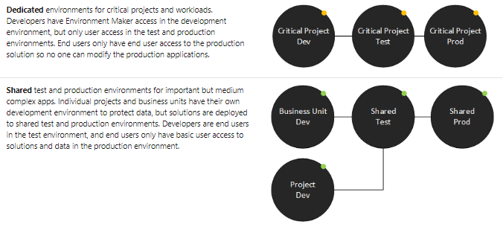


Cutom environments
Custom environments
Work with project teams or business units to establish what environments they need
Work with the teams to establish what connectors are required and create an exception policy.
Work with the teams to establish who will be a maker in this environment.
Notes:
While the shared environments cover many use cases for applications, teams and projects may benefit from having custom environment to support their business unit specific use cases or Application Lifecycle Management scenarios.
Some considerations for custom environments:
Work with the project teams or business units to establish if they require dedicated Development, Test and Production environments or if a dedicated Development environment and shared Test and Production environments are more suitable to their use case.
Work with the business unit to establish which connectors are required and create an exception policy.
Work with the business unit to establish who will be a maker in this environment, and who will be the Environment Administrator.
Each environment consumes 1GB of data capacity, so manage custom environments wisely.
Additional to the above recommendations, establishing your enviornment strategy will also shape and direct your DLP Strategy.

Slide 15

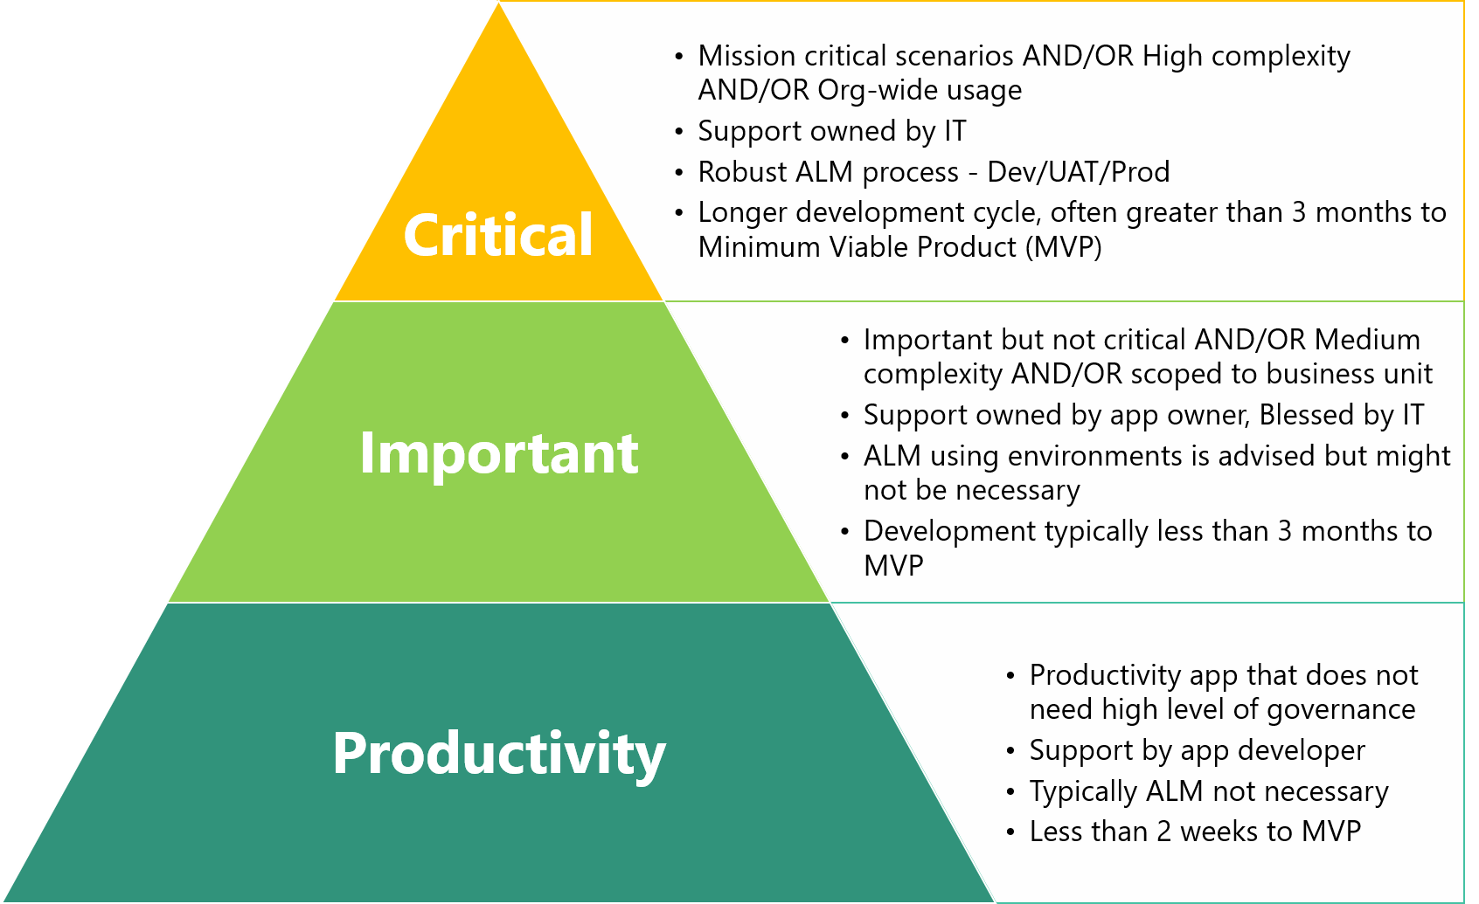

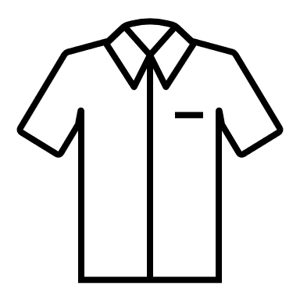
Key considerations
Defined tiers of application support: The level of complexity, how critical the app is, and users impacted by the application are all important measures of how to provision environments to support all the scenarios.
Capacity: Each environment (besides trial and developer environments) will consume 1GB to initially provision. This might be a constraint for provisioning environments
Admin involvement: Automating environment creation and cleanup
Notes:
There are some factors that influence when to provision which types of environments:

Slide 16
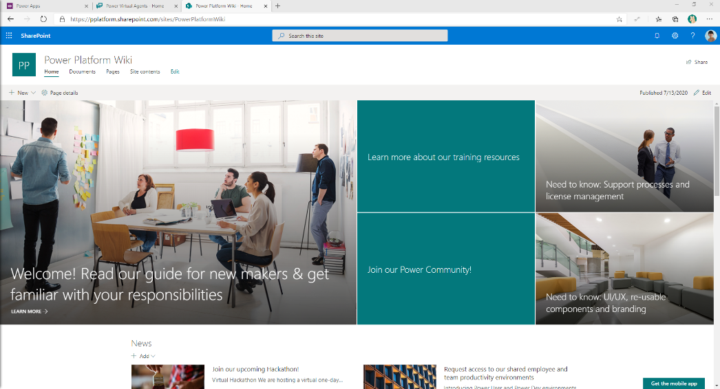
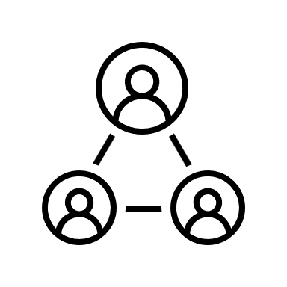
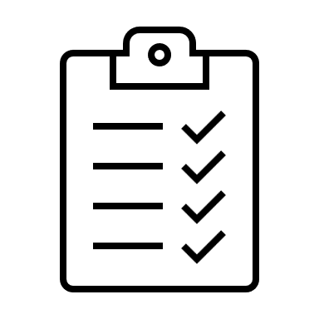
Clearly communicate your strategy to your makers
Purpose of Default, shared team and employee productivity environments
Purpose of Trial and Developer environments
Process of requesting custom environments
Responsibilities of a maker: keep the tenant tidy, share wisely and protect organization data
Notes:
Set up a SharePoint site or a Wiki that clearly communicates:
The purpose of your Default environment
The purpose of shared team and employee productivity environments as well as other shared environments makers might have access to (for example, training environments) and the process of how to request access to those environments.
The purpose of Trial environments and how to request them.
The purpose of Developer environments and how to create them
The process of requesting custom environments for specific business unit or project purposes.
The responsibilities of a maker
Keep the tenant clean. Delete your environments, apps, and flows if they are no longer needed. Use test environments if experimenting.
Share wisely. Watch out for oversharing of your environments, apps, flows, and shared connections.
Protect organization data. Avoid moving data from highly confidential or confidential data sources to non-protected or external storage

